Slide 1
Demo
Enhance user experience with the Powered by AI kit

Slide 2
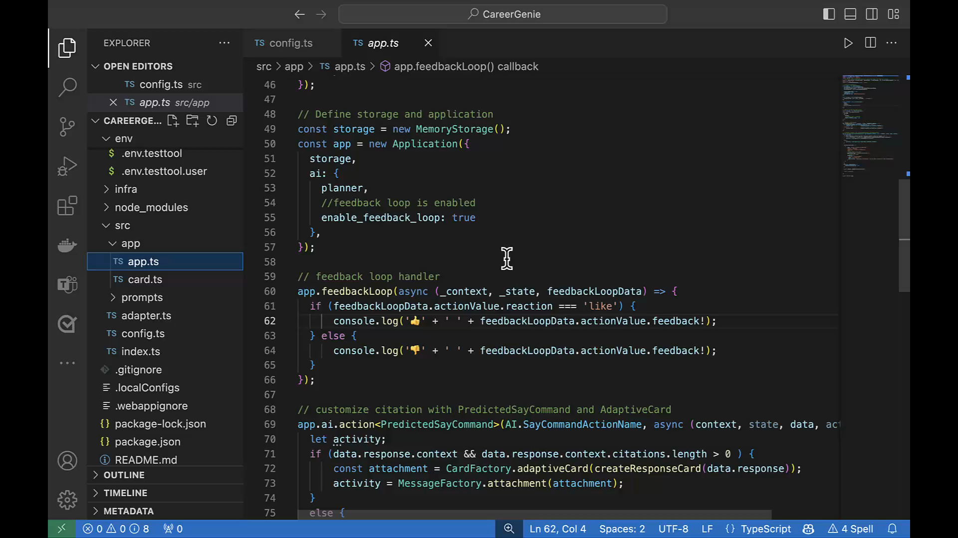

Slide 3

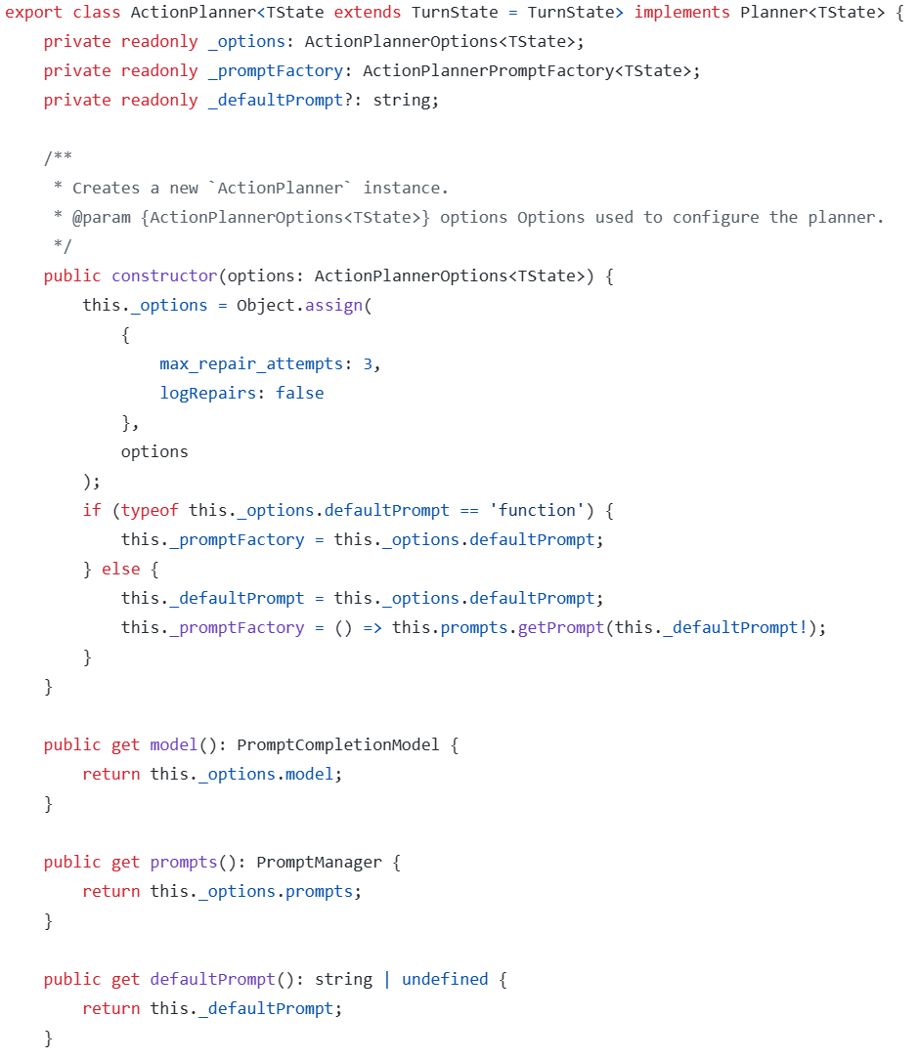
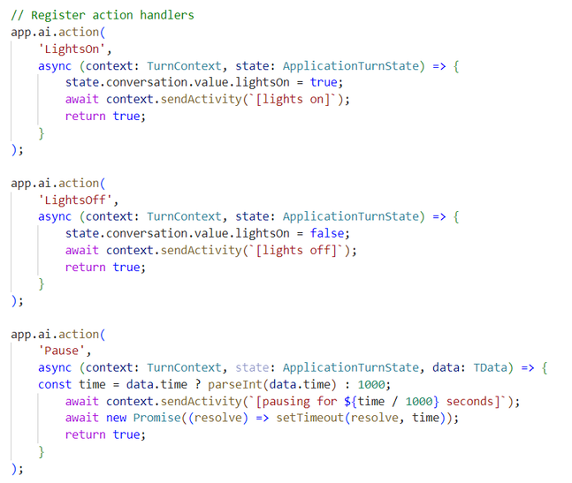
Action handlers
Register a handler for each action listed in the prompt
Returning false from a handler prevents the planner from running additional DO/SAY commands
Add in other actions for AI.UnknownActionName and AI.RateLimitedActionName
Notes:
OK, so far you’ve scaffolded our your copilot, defined your AI parameters, and wrote a schema for a Planner. Now it’s time for your business logic. Actions. You’ll implement the actions you described in your planner. The model does the intent detection, and when it detects an action, it’ll call your business logic here.
A quick digression here because this stuff is very cool. Keep in mind these are called by sophisticated foundational models, and that means they can sometimes predict actions they think you should have, but that you haven’t even implemented yet. We have a nifty feature called an UnknownAction handler that picks these up. You can learn what your users are trying to do, record that, and go off and build it later! It’s real time intent telemetry. We have partners that use this to log all the things their users are trying to do with their copilot, which then funnels into their product plans to go off and implement. This is wild stuff, but I digress. Now, let’s back up and show you how the Northwind Traders copilot took advantage of everything I just talked about with the AI Library.

Slide 4
Demo
Add authentication and actions

Slide 5
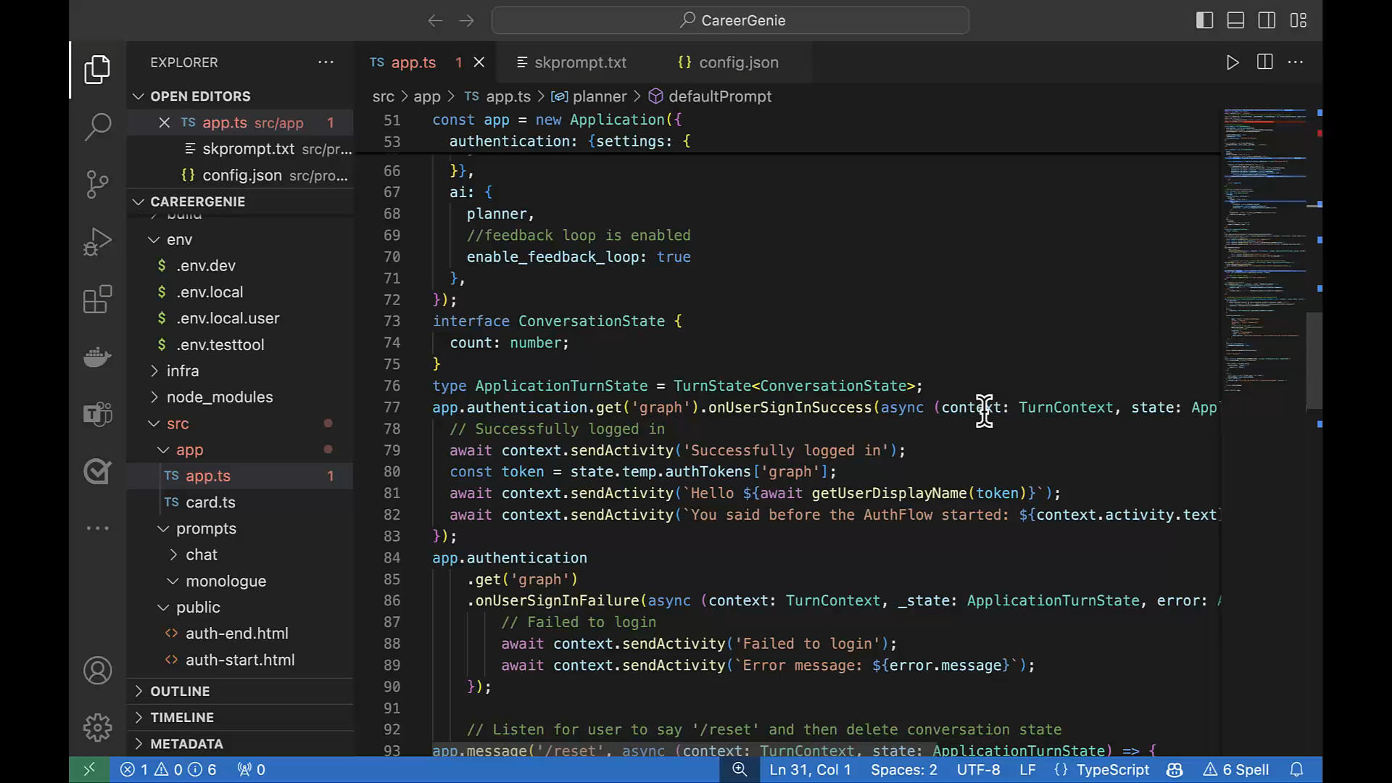

Slide 6
Your copilot checklist
Category | Requirement | Recommended Toolset
Functionality | Use a conversational LLM to manage conversations | Teams AI Library
AI | Leverage an orchestrator to map intent to skills
Authentication | Use single sign-on
UX | Stream responses, progressive loading | Powered by AI UX Kit
UX | AI labelling
UX | Feedback loop
UX | Zero prompts
Copilot Extension | If app contains a plugin, utilize handoff UX between plugin and custom copilot | Teams AI Library

Slide 7
AI Library GitHub repo: aka.ms/teams-ai-repo
Powered by AI UX: aka.ms/powered-by-ai
Adaptive Card starter pack: aka.ms/teams-card-starters
HANDS-ON LAB aka.ms/CopilotDevCamp Try the “Build” path
Please leave feedback in the github repo
References

Slide 8
https://aka.ms/CopilotDevCamp

